Slide 1
Adult Census Income Analysis Team 6
Lecturer: Dr. Arash Azarfar
Team members: Dina Omidvar Tehrani, Niloofar Tavakolian Nastaran Naseri, SeyedehMojdeh Haghighat Hosseini
Notes:
© Copyright PresentationGO.com – The free PowerPoint and Google Slides template library

Slide 2
Overview of the problem
Have you ever wondered what key factors could propel your income to the next level?
Income Patterns
Income Prediction
Lighting Up Inequality & Empowerment
Demographic Insights
Probing Socioeconomic Dynamics
Dissecting Adult Income Factors
2
Notes:
We are trying to Discover the answers with the enlightening insights from our Adult Census Income dataset."
we are curious to learn how 'Unlocking Income Patterns' can help us understand the factors influencing adult income levels.
Also, how 'Income Prediction' could illuminate economic inequality and foster empowerment.
Leveraging this knowledge can empower individuals economically.
And finally, how 'Demographic Insights' can unreveal the socioeconomic dynamics behind income levels?"
Income levels vary among different demographic groups, revealing challenges in our socioeconomic fabric.

Slide 3
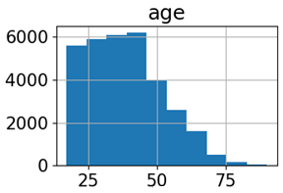
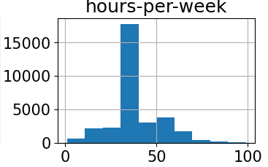
Dataset Selection
Adult Census Income Dataset
Kaggle(48,842 instances and 15 attributes)
Target Variable
Indicates Income level (<=50K or >50K)
Features
Demographic Factors
Age
Socioeconomic Factors
Education
Family and Personal Status
Marital-status
Sex
Race
Native-Country
Education-num (number of educational years completed)
Workclass
Relationship
Economic and Work Factors
Hours-per-week
Capital-gain
Capital-loss
Fnlwgt
Income
Occupation
Distribution of some numerical features
3
Notes:
The Adult Census Income dataset obtained from Kaggle consists of 48,842 instances and 15 attributes.
The target variable in this project indicates income level (<=50K or >50K).
Also features include demographic information, work-related factors, and socioeconomic characteristics of individuals in the United States.
It worth to mention that the "fnlwgt" feature represents the final weight assigned to each observation in the census data. This weight is applied to ensure that the sample accurately represents the population and is a critical component in producing unbiased estimates.
Furthermore, the features "capital.gain" and "capital.loss" capture the financial gains and losses, respectively, that individuals have experienced. These features provide insights into the economic activities and investments made by individuals, which can significantly influence their overall income levels.
Here is Visualization some numerical features of the dataset using histograms to analyze the distribution of those features in the dataset.

Slide 4
Expectations and Goals
Developing a predictive model
Feature importance analysis
Evaluating model performance
Generating actionable insights
Comparing methodologies
Notes:
Our Expectations and goals are as follows:
Developing a predictive model. In this project we implemented three different models including: Decision tree, Semi-supervised learning, and DNN model.
Feature importance analysis consists of identifying influential factors affecting income levels.
Evaluating model performance which include assessing accuracy, precision, recall, and F1-score using appropriate evaluation metrics.
Comparing methodologies: We evaluated different machine learning algorithms and deep learning approaches for predicting income levels.
Generating actionable insights: like Informing policymakers, social scientists, and economists to address income disparities and promote economic equality.
© Copyright PresentationGO.com – The free PowerPoint and Google Slides template library

Slide 5
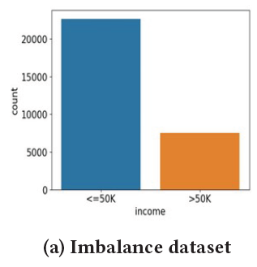



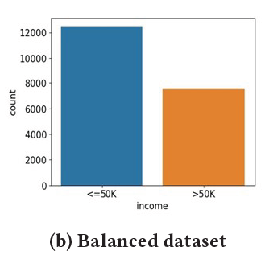
Pre-processing
Dealing with class imbalance
Handling missing values
Dealing with categorical features
Notes:
The challenges that we faced in this study were:
One of the challenges during pre processing step was handling missing values: The challenge of missing values in features like workclass and occupation was addressed by removing the corresponding samples from the dataset to maintain data integrity. Since the percentage of missing values was found to be less down 3% (1.79), we removed them from the dataset.
Also we faced with an imbalance dataset during processing: We handled this issue by undersampling. The target variable exhibited a class imbalance, with a larger number of samples having income <= $50,000. To address this, downsampling of the majority class was performed to create a more balanced dataset, improving prediction accuracy.
The other challenge we encountered Dealing was categorical features in the dataset. To address this problem one-hot encoding was used in this study to effectively transform them into binary vectors.

Slide 6
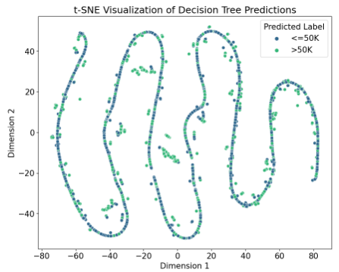
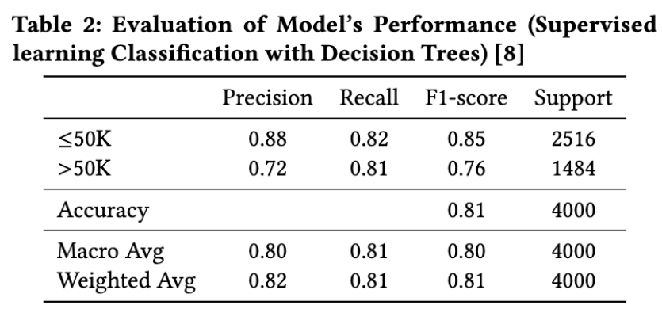
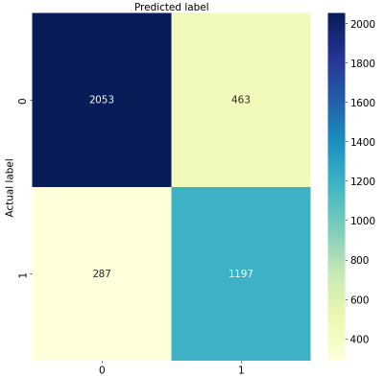
Supervised Learning: Decision Tree classification
Notes:
The first model we implemented was Decision tree. The Decision Tree classifier was created to predict income. The dataset was split into training, validation, and test sets (60%, 20%, and 20% respectively). Categorical variables were converted using one-hot encoding. The Decision Tree was trained with a maximum depth of 11, minimum samples per leaf of 4, and minimum samples for splitting of 2. Accuracy was calculated for the validation and test sets. Here you can see the visualization of TSNE of the model. Also, the classification result is reported in the table , including precision, recall, F1-score, and overall accuracy. Moreover, you can see the heatmap plot of the classification using Decision tree.

Slide 7
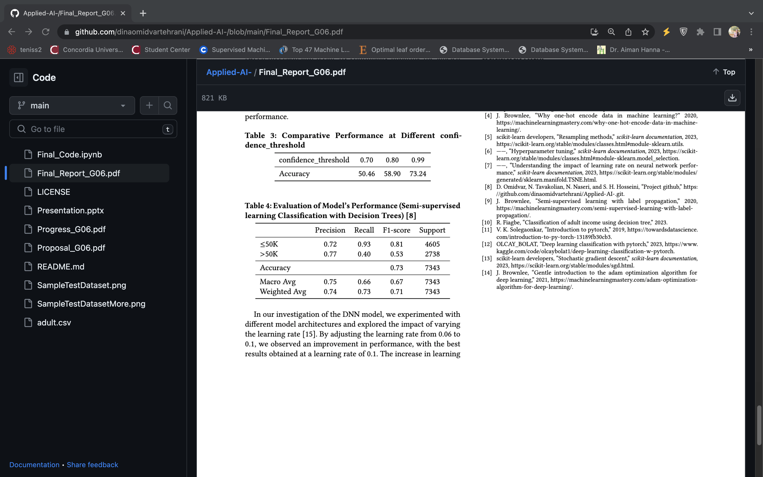
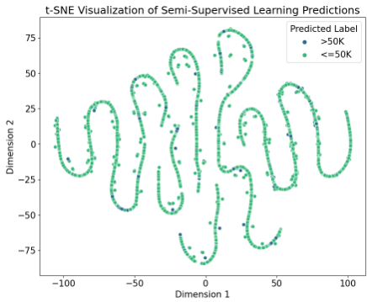
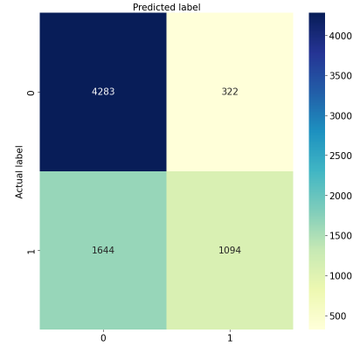
Semi-supervised Learning Using a Decision Tree Classifier
Training and Predictions on labeled and unlabeled Data
2.Probabilities for Predicted Labels
3.Setting Confidence Threshold
4.Identifying Confident Predictions
5.Adding Confident Predictions to Labeled Dataset
6.Appending Features to X_labeled
8.Removing Predicted Samples for Next Iteration
7.Calculating Accuracy of Combined Dataset
7
Notes:
We implemented a semi-supervised learning algorithm using a decision tree classifier. It starts by splitting the labeled and unlabeled datasets into features (X) and target variables (y). The labeled data is used initially to train the decision tree classifier, and the unlabeled data is used for prediction.
The procedure then enters a loop for a specified number of iterations.(you can see the loop in slide) In each iteration:
The decision tree is trained on the labeled data, and predictions are made on the unlabeled data.
Predicted labels are assigned probabilities using the predict_proba function.
A confidence threshold is set to determine which predictions are considered confident.
Confident predictions are identified based on the probabilities exceeding the confidence threshold.
The confident predictions, including their features and labels, are added to the labeled dataset.
The features of the confident predictions are appended to the labeled features (X_labeled).
The accuracy of the combined labeled and unlabeled dataset is calculated.
The confidently predicted samples are removed from the unlabeled dataset for the next iteration.
The purpose of this algorithm is to iteratively improve the model's accuracy by gradually incorporating confident predictions from the unlabeled data into the labeled dataset. This way, it takes advantage of both labeled and unlabeled data to train the decision tree classifier.

Slide 8
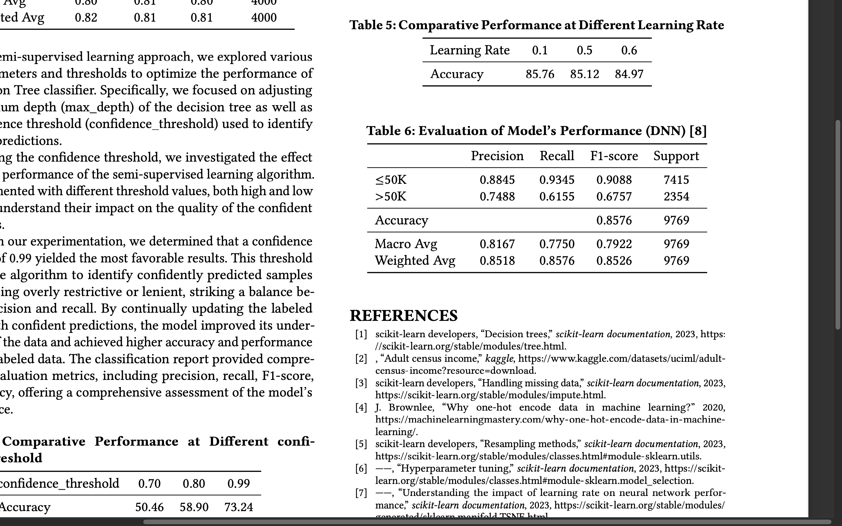
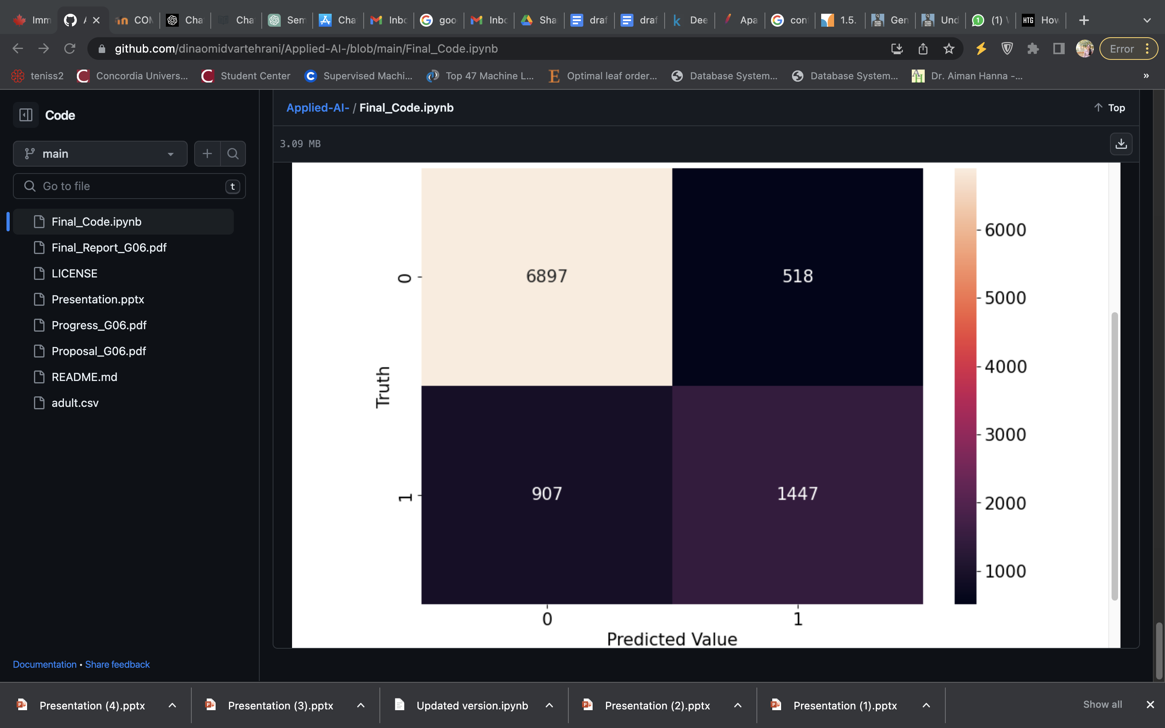
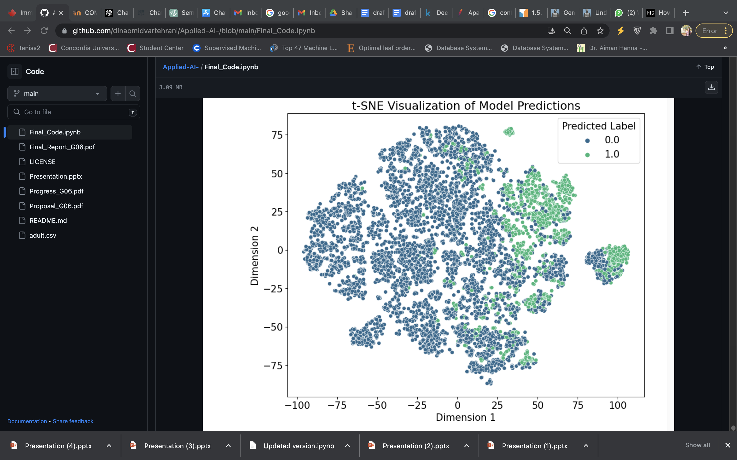
Supervised Learning: Classification with a Deep Learning Model
Layers
Fully connected
FC1,ReLU
Featues in:34
Features out: 64
Dropout
DO1
Fully connected
FC2. ReLU
Featues in:64
Features out: 128
Dropout
DO2
Fully connected
FC3. ReLU
Featues in:128
Features out: 64
Dropout
DO3
FC4. BCE
Featues in:64
Features out: 1
Notes:
In deep neural network model, the data was split into 70% for training and 30% for testing. Using the PyTorch framework, a four-layer neural network was constructed, utilizing ReLU activation function, several dropouts, and trained using stochastic gradient descent over 10,000 epochs.
The model's effectiveness was evaluated with precision, recall, and F1-score metrics, achieving an impressive 85.76% accuracy on the test set. The model excelled in classifying individuals into income categories, highlighting its value in socioeconomic decision-making.
Two vital aspects monitored during the model training were the number of floating-point operations (FLOPs) which is 18881 and the training run time, indicative of the computational efficiency of our Deep Neural Network (DNN) model which is 1068.73 senconds.

Slide 9
Conclusion
Predicting Income
Data pre-processing:
Handling missing values, imbalanced dataset, and categorical features
Decision Tree
Accuracy: 81.1
Semi-Supervised Learning
Accuracy:73.24
DNN Model
Accuracy:85.76
Notes:
In conclusion, our project aimed to analyze and classify income levels based on socio-economic factors utilizing various models, including the Decision Tree model, Semi-supervised learning approach, and DNN model.
Through our research, we have demonstrated the effectiveness of these models in accurately classifying income levels. The Decision Tree model provided interpretable rules, but it had limitations in capturing complex relationships. It achieved an accuracy of 81.12% on the test dataset, indicating its potential for practical use. However, it struggled to handle intricate patterns and achieve higher accuracies.
On the other hand, the DNN model showcased its ability to extract intricate patterns and achieved the highest accuracy among the three models, reaching 85.76%. This underscores the power of deep neural networks in capturing complex relationships and making accurate predictions. The DNN model shows great promise for applications where comprehensive understanding of data is crucial.
While the Decision Tree and DNN models displayed promising results, our semi-supervised learning approach yielded a slightly lower accuracy of 73.24%. Despite this, the semi-supervised learning approach has its merits in scenarios where labeled data is scarce, as it can leverage unlabeled data to enhance the model's performance.

Slide 10
Refrences
“Adult census income,” kaggle, https://www.kaggle.com/datasets/uciml/adult- census- income?resource=download.
“Handling missing data,” scikit-learn documentation, 2023, https://scikit-learn. org/stable/modules/impute.html.
D. Omidvar, N. Tavakolian, N. Naseri, and S. H. Hosseini, “Project github,” https: //github.com/dinaomidvartehrani/Applied- AI- .git.
“Resampling methods,” scikit-learn documentation, 2023, https://scikit-learn. org/stable/modules/classes.html#module- sklearn.utils.
J. Brownlee, “Why one-hot encode data in machine learning?” 2020, https://machinelearningmastery.com/why-one-hot-encode-data-in-machine- learning/.

